Slide 1
Data Structures
12. Binary Search Tree: Practice

Slide 2
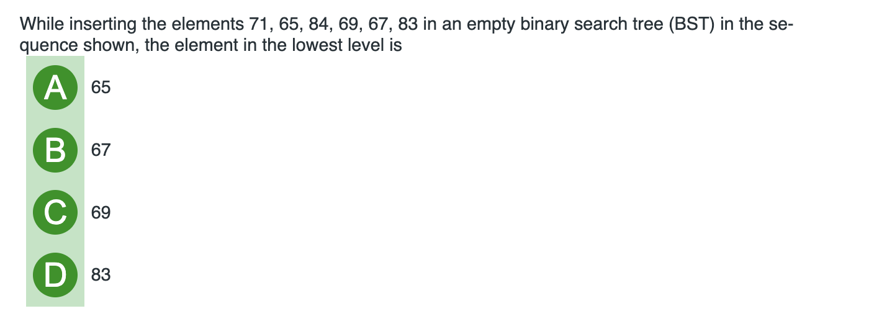
BST’s Practice

Slide 3
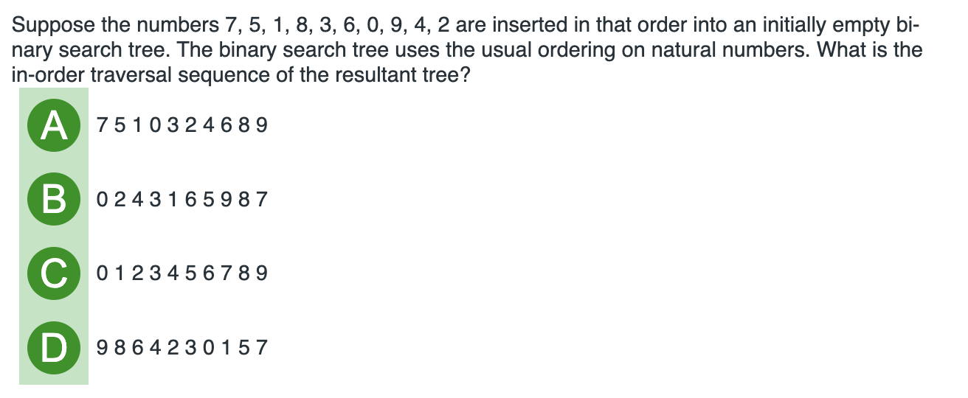
BST’s Practice

Slide 4
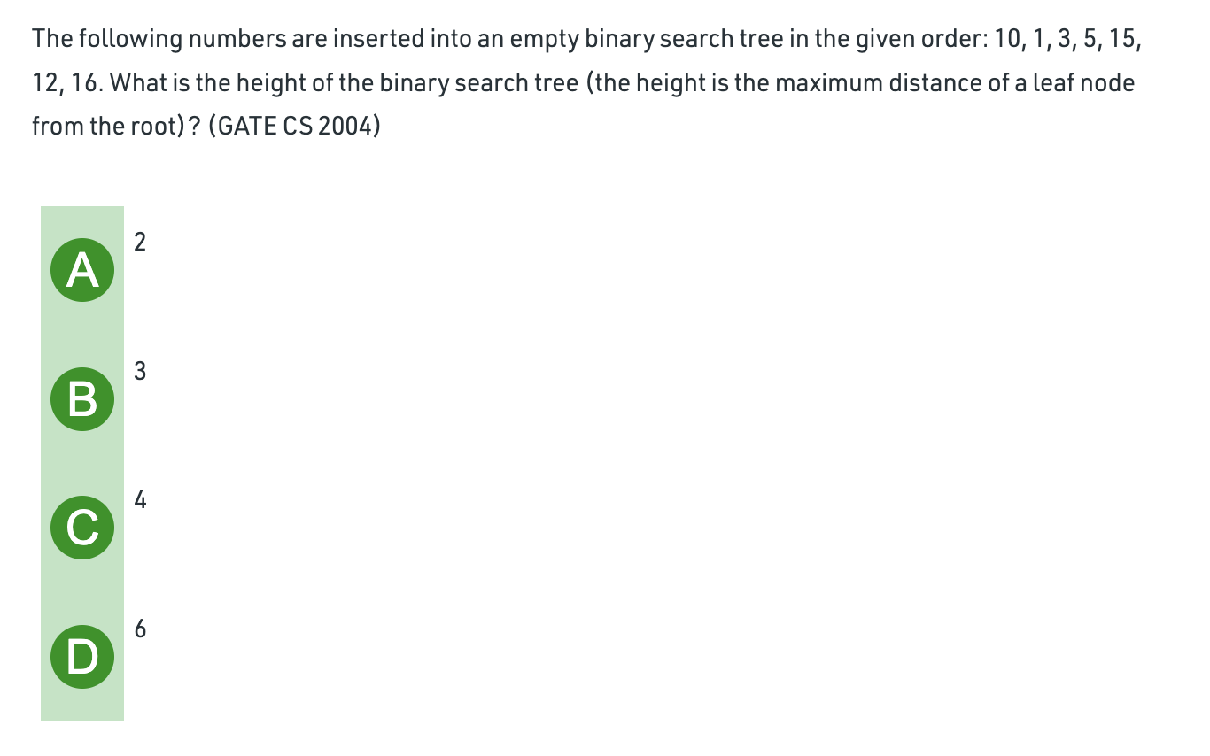
Notes:
Answer: B

Slide 5
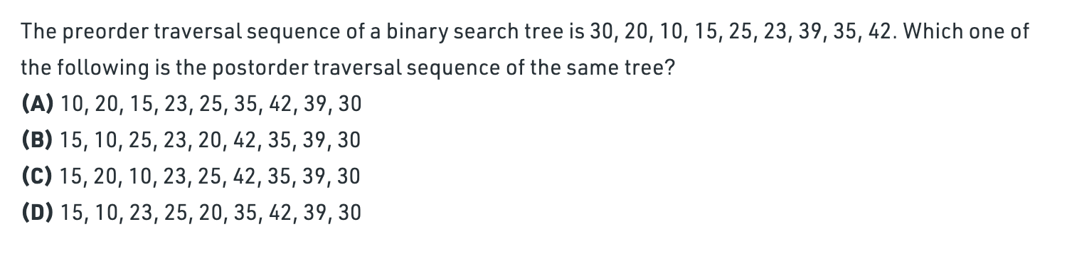
Constructing a Binary Search Tree Given its pre-order traversal
Notes:
Answer: D
How to construct binary search tree given its pre-order traversal?
https://www.geeksforgeeks.org/construct-bst-from-given-preorder-traversa/

Slide 6
Constructing a Binary Search Tree Given its postorder traversal
Construct a binary tree given its postorder traversal:
{1, 7, 5, 50, 40, 10}
Notes:
How? Last element is root, so the root is 10.
Look for the last value less than 10 : 5
Then look for last value less than 10: 7
Then 1.
Reverse them.
So 1, 7, 5 becomes the left subtree.
Now apply recursively same procedure to it. 5 becomes root, then 1 and 7 left and right.

Slide 7
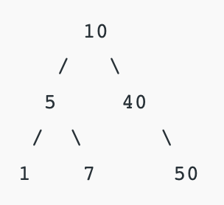
Answer to previous question will be:

Slide 8
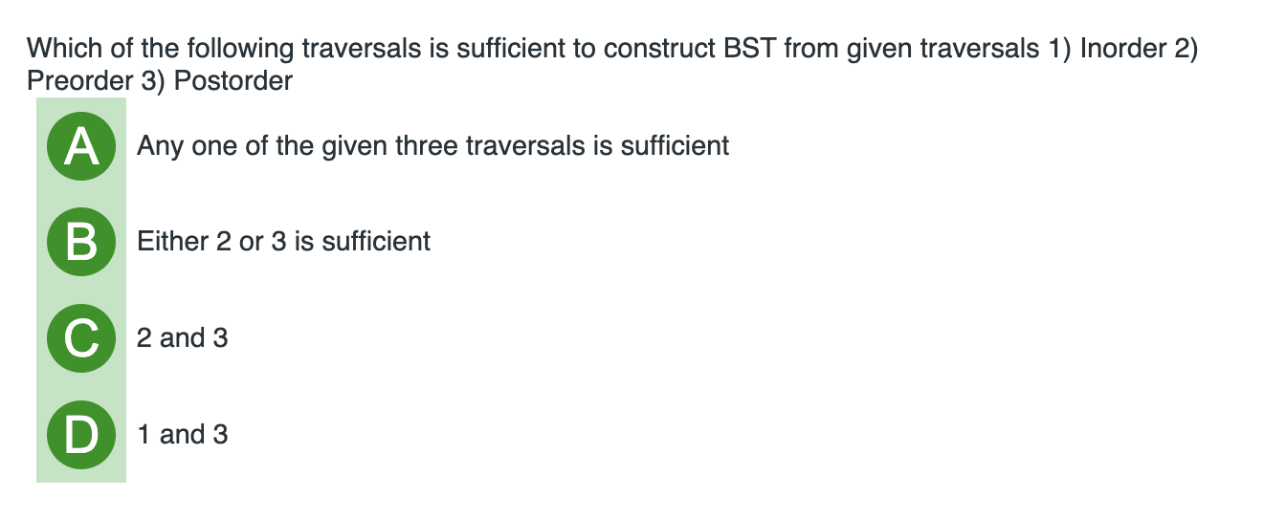
Can a specific tree be constructed from inorder traversal?
Notes:
Answer: B

Slide 9
Coding Task
Given an integer sequence representing the inorder traversal of a binary search tree, construct the tree, then determine using a recursive function isValid whether it is a valid binary search tree. Test your program by giving as input the inorder traversal of a valid tree as well as an invalid tree.
Write a function findInorderSuccessor that can print the inorder successor of any node in a BST. Use a valid BST for testing this function.
Write a delete function that can delete any node from the tree. Node will be given as user input. You must use the function findInorderSuccessor that you wrote earlier.
Write code to construct a binary search tree given its postorder traversal.
A driver program should demonstrate all the above functions. You should have enough output statements to show the user of the program what is happening. Print the BST after every function and insertion/deletion.

Slide 10
Any Question So Far?

